Slide 1
Lecture 05 - Feature Extraction
Prof. André Gustavo Hochuli
gustavo.hochuli@pucpr.br
aghochuli@ppgia.pucpr.br
Notes:
Prof. André Hochuli

Slide 2
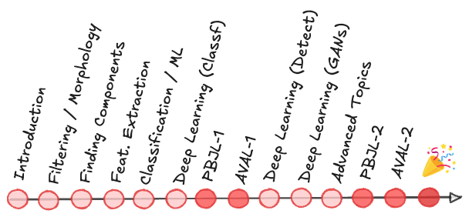
Topics
[Recap] Lecture 04 – Finding Components
Lecture 05 - Feature Extraction
Feature Vector / Embeddings / Representations
Feature Space
Feature Engineering
Descriptors
Practice
Computer Vision - Prof. André Hochuli
Lecture 05
Notes:
Prof. André Hochuli

Slide 3
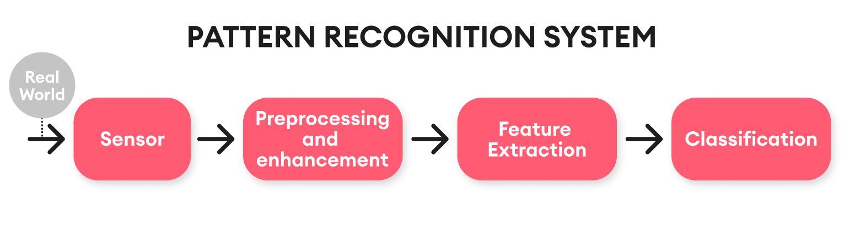
Computer Vision & Pattern Recognition Pipeline
Computer Vision - Prof. André Hochuli
Lecture 05
Notes:
Prof. André Hochuli

Slide 4
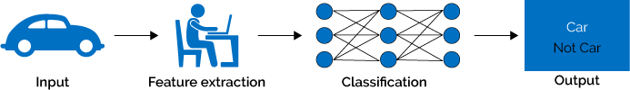
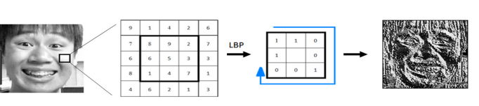
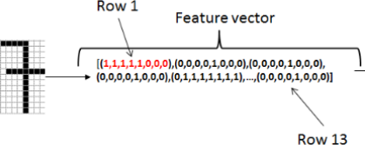
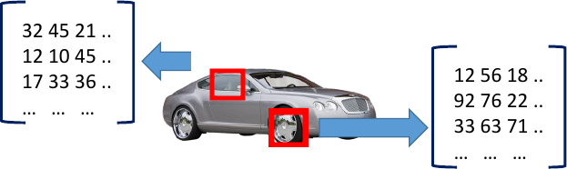
Feature Extraction
A feature descriptor translates high-dimensional data to a a low dimension feature space
A feature vector represents the input data produced by the feature descriptor
Later, a machine learning model will learn the representations
Computer Vision - Prof. André Hochuli
Lecture 05
Notes:
Prof. André Hochuli

Slide 5

Feature Extraction
Let us represent an image by its dimensions. Thus, an image ‘I’ belonging to class ‘X’ can be represented as:
f(I,X) = [I.width,I.heigth,X]
LET’S CODE: Lecture_05_Feature_Extraction_Projections.ipynb
Computer Vision - Prof. André Hochuli
Lecture 05
Notes:
Prof. André Hochuli

Slide 6
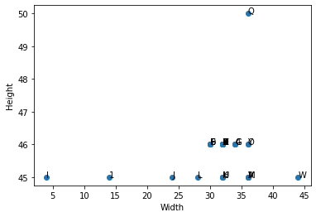
Feature Vector
Does this feature vector provide a representative encoding of the image?
Computer Vision - Prof. André Hochuli
Lecture 05
Notes:
Prof. André Hochuli

Slide 7
Feature Vector
Does this feature vector provide a representative encoding of the image?
Computer Vision - Prof. André Hochuli
Lecture 05
Notes:
Prof. André Hochuli

Slide 8

Feature Vector
Does this feature vector provide a representative encoding of the image?
Computer Vision - Prof. André Hochuli
Lecture 05
Notes:
Prof. André Hochuli

Slide 9
Feature Vector
Is the feature vector representative?
Computer Vision - Prof. André Hochuli
Lecture 05
Notes:
Prof. André Hochuli

Slide 10
Feature Vector
Does this feature vector provide a representative encoding of the image?
Non Discriminative
Computer Vision - Prof. André Hochuli
Lecture 05
Notes:
Prof. André Hochuli

Slide 11
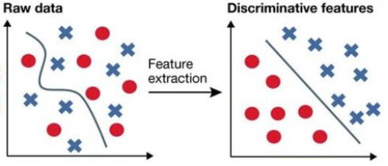
Feature Engineering
How to produce a discriminative feature space?
Features must describe a singular characteristic of the problem for good generalization.
Computer Vision - Prof. André Hochuli
Lecture 05
Notes:
Prof. André Hochuli

Slide 12
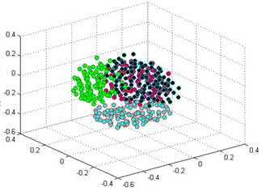
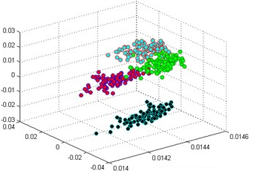
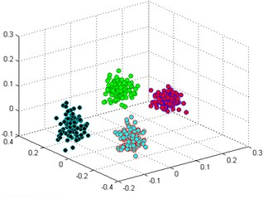
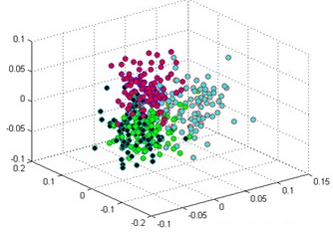
Problem
How discriminating are features?
Input Space
Feature Space’
Feature Space’’
Feature Space ’’’
Computer Vision - Prof. André Hochuli
Lecture 08
Notes:
Prof. André Hochuli

Slide 13
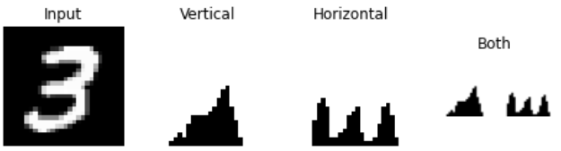
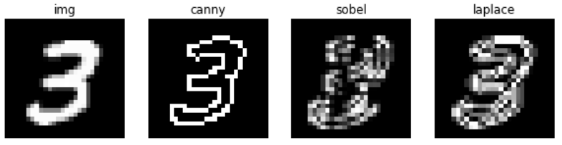
Image Descriptors – Shape/Edges
Gradient Based
Projections
Convolutional (Filters)
Computer Vision - Prof. André Hochuli
Lecture 06
Notes:
Prof. André Hochuli

Slide 14
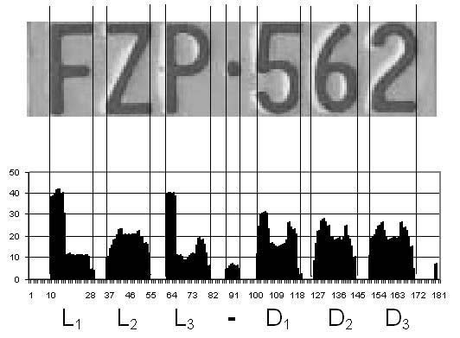
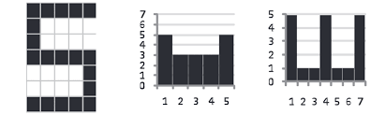

Image Descriptors
Vertical and Horizontal Projection
LET’S CODE: Lecture_05_Feature_Extraction_Projections.ipynb
Computer Vision - Prof. André Hochuli
Lecture 05
Notes:
Prof. André Hochuli

Slide 15
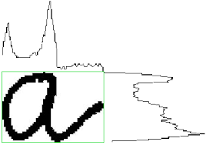
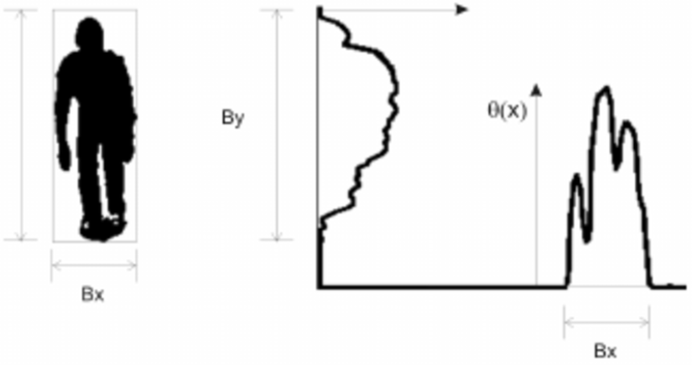
Image Descriptors – Shape
Computer Vision - Prof. André Hochuli
Lecture 06
Notes:
Prof. André Hochuli

Slide 16
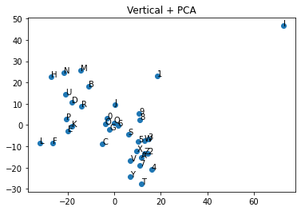
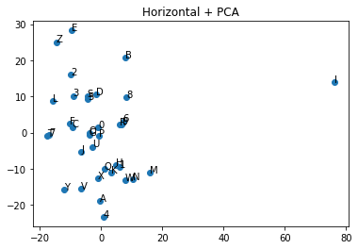
Image Descriptors
f(I,X) = [I.width,I.heigth,X]
Vertical and Horizontal Projection
Computer Vision - Prof. André Hochuli
Lecture 05
Notes:
Prof. André Hochuli

Slide 17
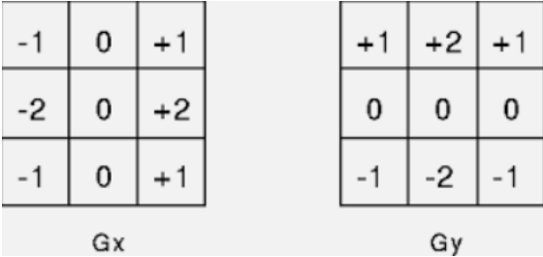
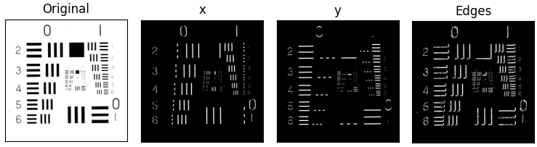
Image Descriptors – Edges
Let’s Code: Lecture_05_Image_Descriptors_Edges.ipynb
Sobel Filter
Computer Vision - Prof. André Hochuli
Lecture 06
Notes:
Prof. André Hochuli

Slide 18
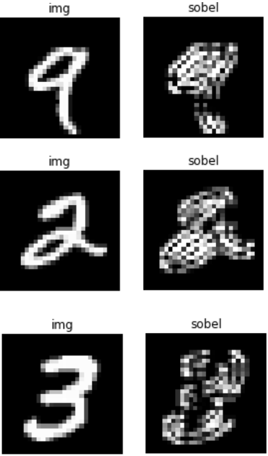
Image Descriptors – Edges
Sobel Filter
Computer Vision - Prof. André Hochuli
Lecture 06
Notes:
Prof. André Hochuli

Slide 19
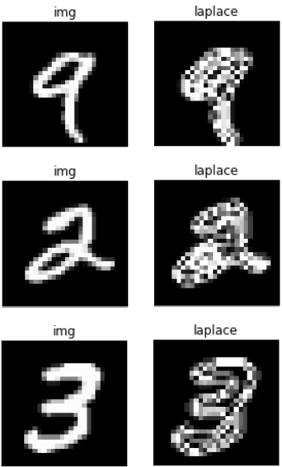
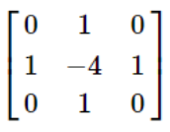
Image Descriptors – Edges
Laplace
Computer Vision - Prof. André Hochuli
Lecture 06
Notes:
Prof. André Hochuli

Slide 20
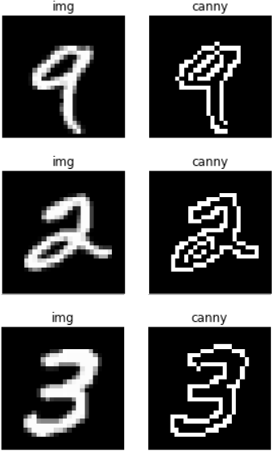
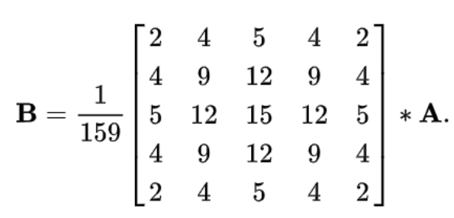
Image Descriptors – Edges
Canny (John F. Canny 1986)
Gaussian Gradient Based Filter
Gaussian Blur
Gradient Detection
Computer Vision - Prof. André Hochuli
Lecture 06
Notes:
Prof. André Hochuli

Slide 21
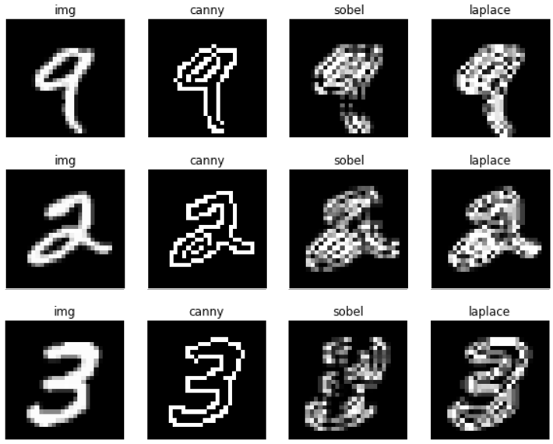
Image Descriptors – Edges
Computer Vision - Prof. André Hochuli
Lecture 06
Notes:
Prof. André Hochuli

Slide 22
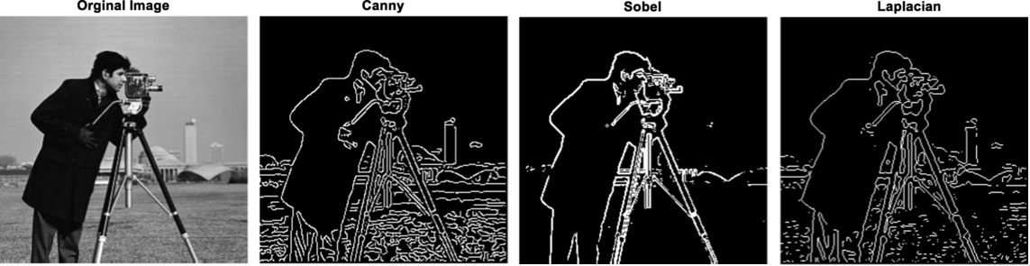
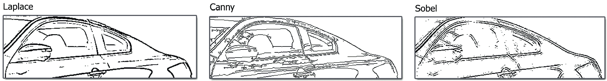
Image Descriptors – Edges
Let’s Code: Lecture_05_Image_Descriptors_Edges.ipynb
Computer Vision - Prof. André Hochuli
Lecture 06
Notes:
Prof. André Hochuli

Slide 23

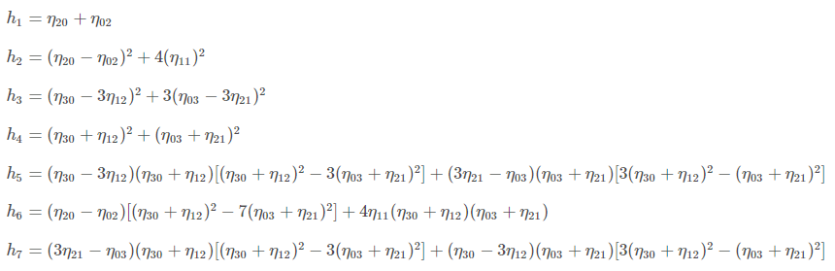
Image Descriptors – Shape
Let’s Code: Lecture_05_Image_Descriptors_Texture_and_Others.ipynb
Moments
Values that carry both spatial and intensity information (shape)
Weighted average of all pixel's intensities
I(x,y) ➔ pixel coordinates of input
Powers, p and q, are the weights of the horizontal and vertical dimensions
HuMoments (Hu 1962)
Translation and Scale Invariant
https://github.com/andrehochuli/teaching/blob/main/ComputerVision/Lecture%2005%20-%20Feature%20Extraction/Lecture_05_Image_Descriptors_Texture_and_Others.ipynb
Computer Vision - Prof. André Hochuli
Lecture 07
Notes:
Prof. André Hochuli

Slide 24
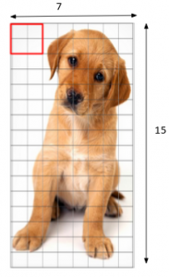
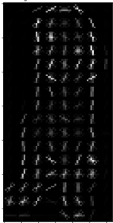
Image Descriptors – Shape
HoG – Histogram of Oriented Gradients
Computes the gradient and orientation of edges
Use a kernel to compute the Gradients (i.e 9x1)
Patch-Based Histogram (8x8, 16x16..)
Computer Vision - Prof. André Hochuli
Lecture 07
Notes:
Prof. André Hochuli

Slide 25
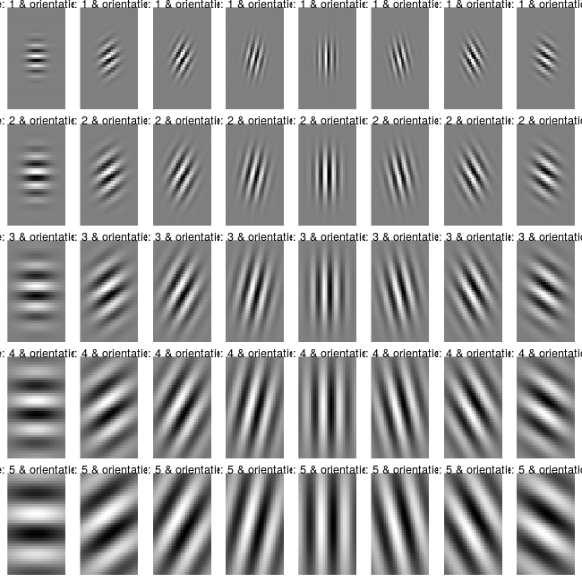
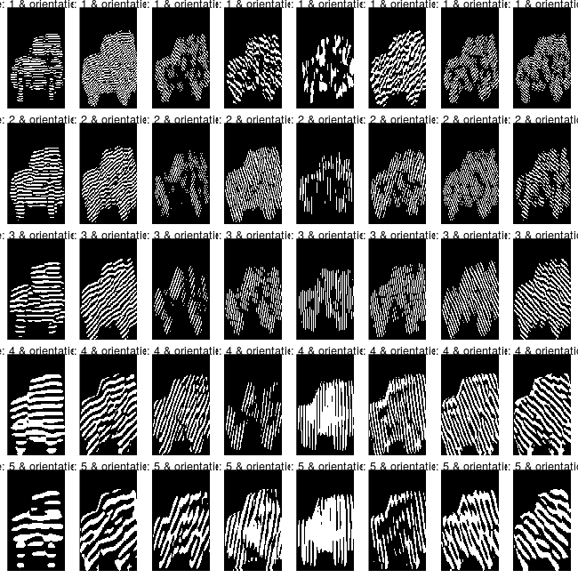
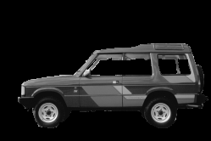
Image Descriptors – Texture
Gabor Filters
Convolves the image using several Gaussian Kernels (Kernel Bank)
Computer Vision - Prof. André Hochuli
Lecture 07
Notes:
Prof. André Hochuli

Slide 26
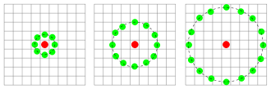
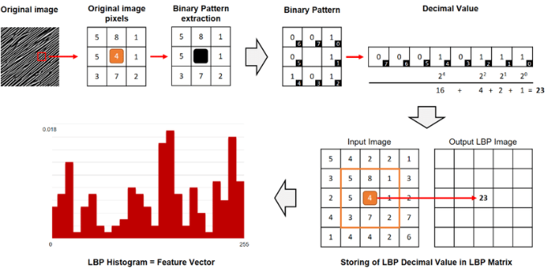
Image Descriptors – Texture
Local Binary Patterns
Convolves the image using a Circular Kernel
The resulting pixel is computed in the binary neighborhood
Let’s Code: Lecture_05_Image_Descriptors_Texture_and_Others.ipynb
Computer Vision - Prof. André Hochuli
Lecture 07
Notes:
Prof. André Hochuli

